Slide 1





Advanced Programming Techniques - Week 2
Creational Design Patterns
A systematic approach to object creation in software development
What are Creational Design Patterns?
Fundamental solutions for flexible object creation
Why use them?
Enhanced flexibility, reusability, and maintainability in your code
Types of Patterns
Builder, Singleton, Prototype, Factory, Abstract Factory
Code Examples & Best Practices
Practical implementations and industry standards

Slide 2
What are Creational Design Patterns?
1
Definition
2
Why use them?
3
Benefits
Creational design patterns focus on efficient and flexible object creation.
Improves code organization
Increases maintainability
4
Advantages
5
Support
Decouples object creation from usage
Supports flexibility in adding new types of objects

Slide 3
Builder Pattern
Definition
Key Properties for Correct Implementation
The Builder Pattern constructs complex objects step by step.
✅ Follows method chaining (return this) for readability.
✅ Keeps the object immutable once created.
Useful for objects with many optional parameters.
✅ Separates object construction from representation.
Ensures a clear object creation process and can help achieve immutability.

Slide 4

Design Diagram
classDiagram class House { +String foundation +String walls +String roof } class HouseBuilder { +setFoundation(String foundation) +setWalls(String walls) +setRoof(String roof) +build(): House } HouseBuilder --> House

Slide 5
Builder Pattern Example Code
class House { private String foundation; private String walls; private String roof; private House(HouseBuilder builder) { this.foundation = builder.foundation; this.walls = builder.walls; this.roof = builder.roof; } public void show() { System.out.println("House with " + foundation + ", " + walls + " walls, and a " + roof); }
static class HouseBuilder { private String foundation; private String walls; private String roof; public HouseBuilder setFoundation(String foundation) { this.foundation = foundation; return this; } public HouseBuilder setWalls(String walls) { this.walls = walls; return this; } public HouseBuilder setRoof(String roof) { this.roof = roof; return this; } public House build() { return new House(this); } } }

Slide 6
Singleton Pattern
Definition
Key Properties for Correct Implementation
The Singleton Pattern ensures only one instance of a class exists.
✅ Must be thread-safe.
✅ Must be accessible globally.
Used for shared resources like database connections, logging, or configuration settings.
✅ Supports lazy initialization without breaking accessibility.

Slide 7
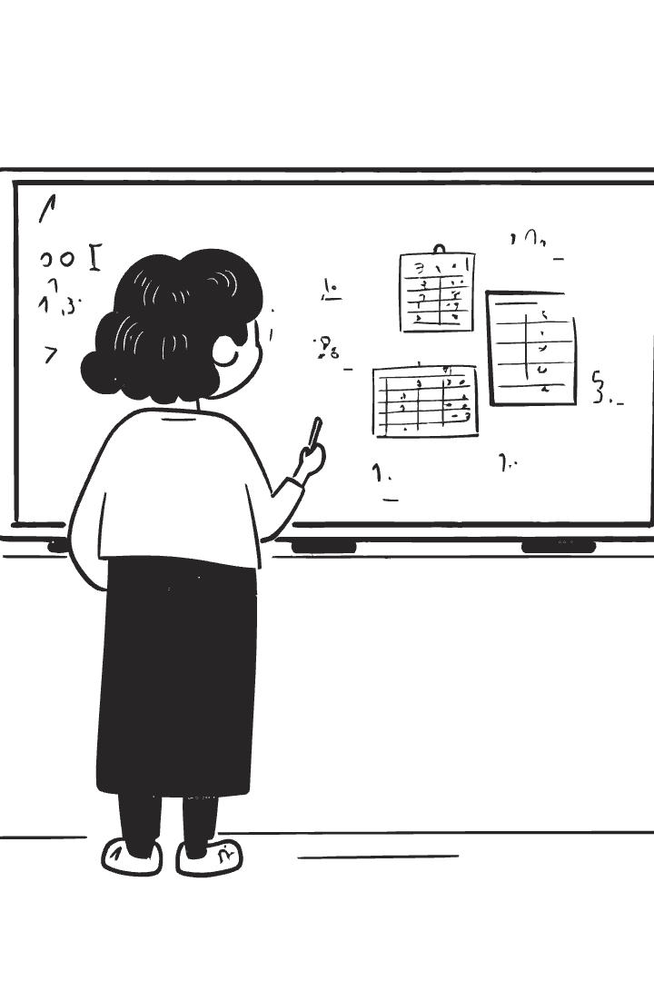
Singleton Pattern Design Diagram
Design Diagram
classDiagram class Singleton { -static Singleton instance -Singleton() +static Singleton getInstance() }

Slide 8

Singleton Pattern Example Code
class Singleton { private static volatile Singleton instance; private Singleton() { } // Private constructor public static Singleton getInstance() { if (instance == null) { synchronized (Singleton.class) { if (instance == null) { instance = new Singleton(); } } } return instance; } }

Slide 9



Prototype Pattern
Definition
Key Properties
The Prototype Pattern creates new objects by cloning an existing one.
✅ Implements Cloneable or deep copy mechanism.
✅ Reduces the cost of creating new instances.
Useful when object creation is expensive.

Slide 10

Prototype Pattern Design Diagram
Design Diagram
classDiagram class Shape { +clone(): Shape } class Circle { +clone(): Circle } Shape <|-- Circle

Slide 11

Prototype Pattern Example Code
abstract class Shape implements Cloneable { public abstract void draw(); public Object clone() throws CloneNotSupportedException { return super.clone(); } } class Circle extends Shape { public void draw() { System.out.println("Drawing a circle..."); } } public class PrototypeDemo { public static void main(String[] args) throws CloneNotSupportedException { Circle circle1 = new Circle(); Circle circle2 = (Circle) circle1.clone(); // Cloning the object circle1.draw(); // Output: Drawing a circle... circle2.draw(); // Output: Drawing a circle... } }

Slide 12





Factory Method Pattern
Definition
The Factory Method Pattern creates objects through a common interface while deferring instantiation to subclasses.
Key Properties
✅ Uses inheritance to delegate object creation.
Benefits
✅ Reduces tight coupling.
Advantages
✅ Provides a single entry point for object creation.

Slide 13
Factory Pattern Design Diagram
classDiagram
class Vehicle {
+drive()
}
class Car {
+drive()
}
class VehicleFactory {
+createVehicle(): Vehicle
}
VehicleFactory <|-- Car

Slide 14

Factory Pattern Example Code
abstract class Vehicle { public abstract void drive(); } class Car extends Vehicle { public void drive() { System.out.println("Driving a car..."); } } abstract class VehicleFactory { public abstract Vehicle createVehicle(); } class CarFactory extends VehicleFactory { public Vehicle createVehicle() { return new Car(); } }

Slide 15

Abstract Factory Pattern
Definition
The Abstract Factory Pattern provides an interface for creating families of related objects without specifying their concrete classes.
Key Properties
✅ Supports multiple families of objects.
Benefits
✅ Avoids hard-coded class dependencies.
Advantages
✅ Ensures objects created together are compatible.

Slide 16

Abstract Factory Pattern Design Diagram
classDiagram
class GUIFactory {
+createButton(): Button
+createCheckbox(): Checkbox
}
class WindowsFactory {
+createButton(): WindowsButton
+createCheckbox(): WindowsCheckbox
}
class MacFactory {
+createButton(): MacButton
+createCheckbox(): MacCheckbox
}
GUIFactory <|-- WindowsFactory
GUIFactory <|-- MacFactory

Slide 17

Abstract Factory Pattern Example Code
interface GUIFactory {
Button createButton();
Checkbox createCheckbox();
}
class WindowsFactory implements GUIFactory {
public Button createButton() {
return new WindowsButton();
}
public Checkbox createCheckbox() {
return new WindowsCheckbox();
}
}

Slide 18





Summary & Key Takeaways
Singleton
Builder
2
Ensures a single instance exists (thread-safe, lazy-loaded).
Constructs complex objects step by step.
1
Prototype
3
Creates objects via cloning to optimize performance.
5
Abstract Factory
Creates families of related objects without specifying concrete classes.
4
Factory Method
Provides a method to create objects through an interface.

